Slide 1
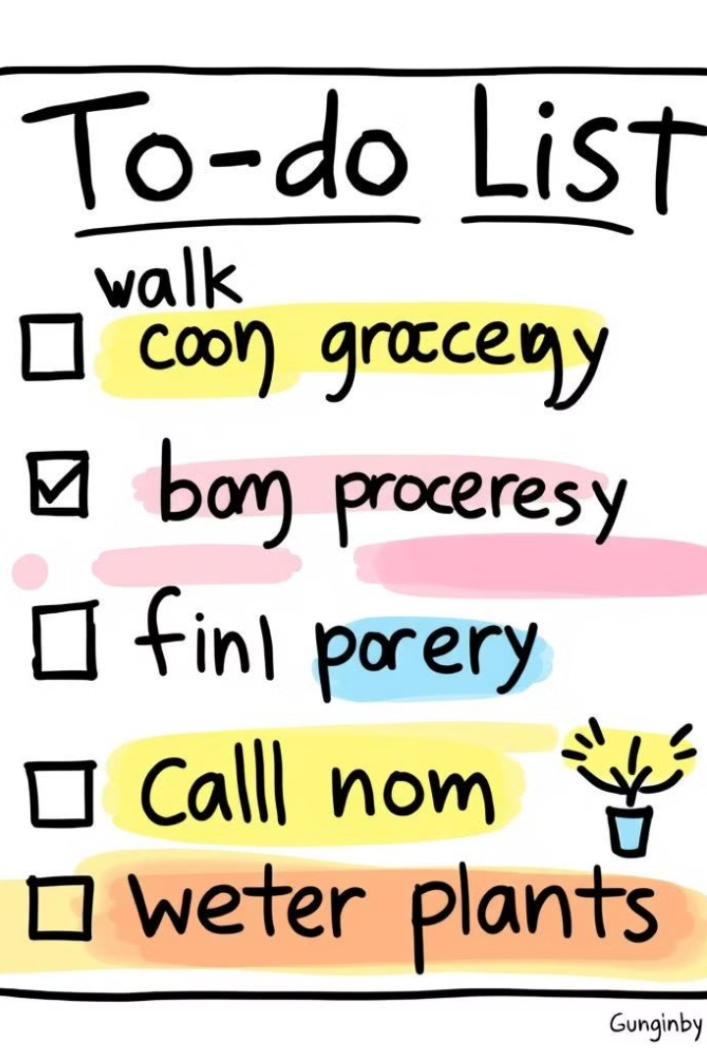
To-Do List Application
This application allows you to organize your daily tasks, track progress, and stay on top of your schedule. The app is built using HTML, CSS, and JavaScript, and it features a simple and intuitive interface.
Made By : Lakshay Jain
Roll No. : 2200290120095
Branch : CS
Sec : 5B

Slide 2

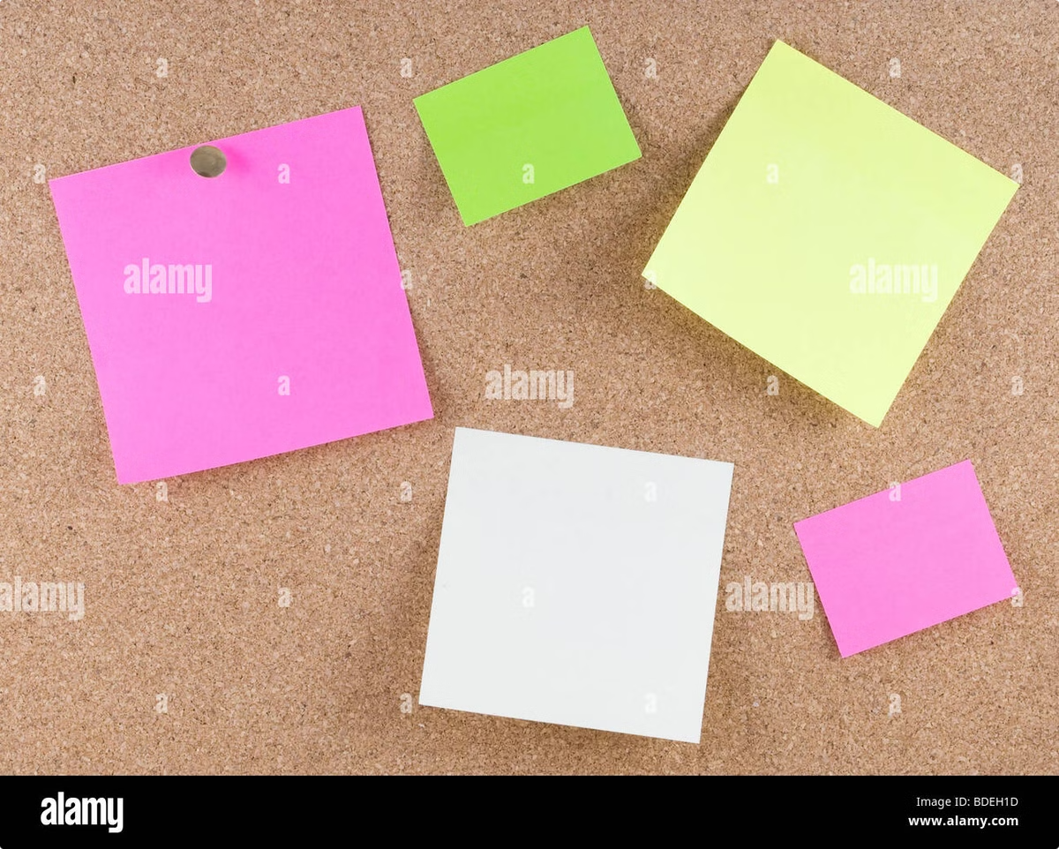
Introduction to the To-Do List App
Simplicity
Efficiency
The app has a clean and minimalist design, making it easy to navigate and use.
The To-Do List app is designed to help you stay organized and efficient by providing a central place to manage your tasks.
Accessibility
The application is accessible on any device with a web browser, making it convenient for users on the go.

Slide 3

Key Features
1
Adding Tasks
2
Deleting Tasks
Users can easily add new tasks to their list by entering text into a designated input field.
Unnecessary tasks can be removed from the list by clicking a delete button associated with each task.
3
Marking Tasks as Complete
4
Task Tracking
All added tasks are displayed in a list, allowing users to view and manage their outstanding items
Users can check off completed tasks, changing their appearance to track progress..

Slide 4
Functionality for Task Management
Adding Tasks
Marking Tasks as Complete
Users input text into a designated field. The app stores this text in a data structure, such as an array, to keep track of tasks.
Each task has a checkbox. When checked, the app updates the data structure to mark the task as complete and visually changes its appearance, possibly by striking it through.
1
2
3
Deleting Tasks
Each task has a delete button. Clicking it triggers a function that removes the corresponding task from the data structure and updates the displayed list.

Slide 5
Code Structure
Arrays
Loops
DOM Manipulation
An array stores the list of tasks as strings, allowing easy manipulation of individual task items.
Loops are used to iterate through the array, displaying each task as an item in the HTML list.
JavaScript interacts with the HTML elements to add, delete, and update the list of tasks based on user interactions.

Slide 6

Conclusion
1
Organization
The To-Do List app helps users stay organized and manage their tasks efficiently.
2
Productivity
By tracking progress and providing a clear overview of tasks, the app boosts productivity.
3
Satisfaction
Completing tasks and achieving goals is rewarding, promoting a sense of accomplishment and satisfaction.

Slide 7
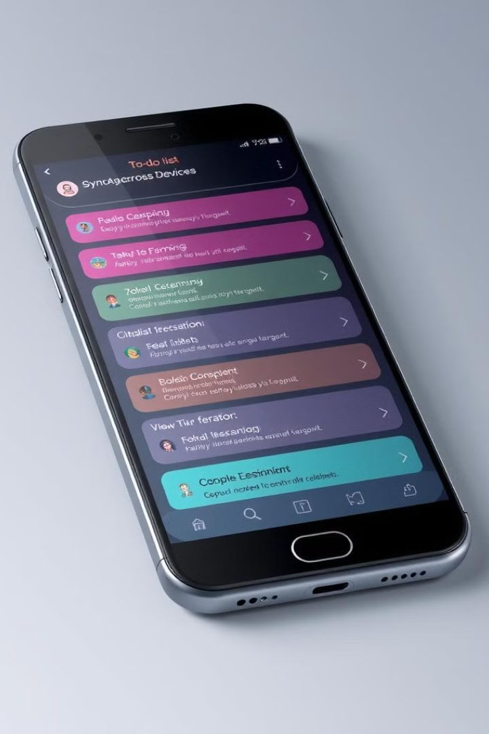



Future Enhancements
Syncing Across Devices
Allow users to access their to-do lists from multiple devices and keep them synchronized.
Reminders
Implement reminders for upcoming tasks to ensure that users don't miss deadlines.
Categorization
Enable users to categorize tasks for better organization and prioritization.

Slide 8

Thank You
Thank you for your time and interest in my To-Do List app. I hope this presentation provided you with valuable insights into its features and benefits.

